Slide 1
Battleship Tutorial
Click to Start

Slide 2
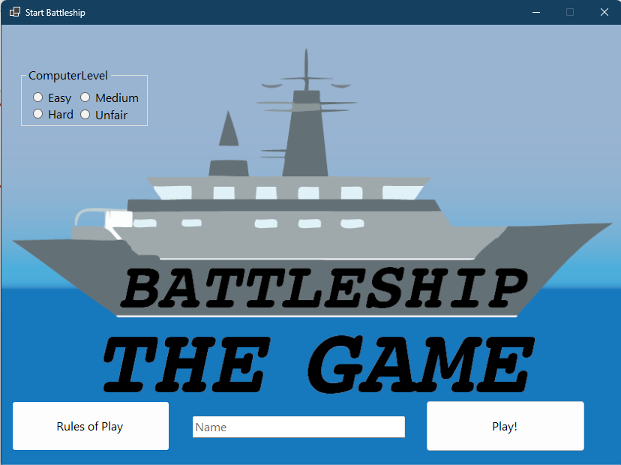
Welcome to Battleship!
This tutorial will explain how to play the game.
When you are ready, click the battleship to start.

Slide 3
Let’s start by choosing the computer difficulty. We will start with the Easy Difficulty.
Click it.

Slide 4
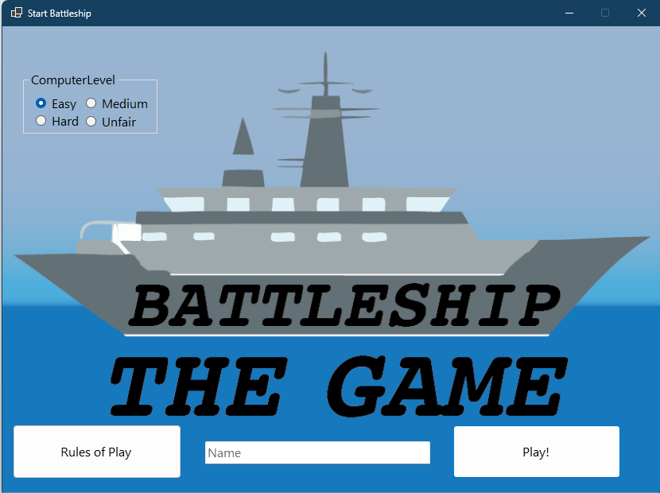
Nice!

